Slide 1
Polymorphism

Slide 2
What is polymorphism?
Polymorphism is a Greek word meaning "one name many forms"."Poly" means many and "morph" means forms. Polymorphism provides the ability to class multiple implementations with the same name.
Polymorphism is a way in which we can define multiple functions in a single name i.e. single name and multiple meaning.

Slide 3
Types of Polymorphism
There are basically the following two types of polymorphism in C#:
Static / Compile Time Polymorphism.
Dynamic / Runtime Polymorphism.

Slide 4
Real life example
Suppose in this week I have to go to Mumbai for meeting on Nov 14, 2015. I have total 2 mobile numbers of cab drivers. So out of that, I called Sachin & told him we have to go Mumbai on Nov 14, at 5.00 AM. He told that he will come on sharply at 5.00 AM & will go. So, for this week I will come & attend the seminar.

Slide 5
Real life example
Now in the next month, I have to go to Delhi. So again I called Sachin & asked him whether he is free or not. He told me that he is having another tour so he is not free in the coming month. He gave me his associate office contact number & told that you can call them they will arrange another cab for you. So I called their office & told them the date time & my house address for pick up. The call attendee (office receptionist boy) asked me which cab do you need, he told different rates as per the cab facilities, such AC, Non-AC. After taking complete information from me he told that our drive will come on time at your home.

Slide 6


Real life example
In the first situation, I know that Sachin will definitely come i.e. Compile Time Binding. In second situation, I don’t know who will come (I don’t know the name of THE person) i.e. Run Time Binding.

Slide 7
Static or Compile Time Polymorphism
There are two ways to achieve Compile Time Polymorphism:
Function Overloading
Operator Overloading

Slide 8
Function Overloading
Function overloading means writing a function with the same name, but different definitions. Whenever we call this function we can call by using the same name.

Slide 9
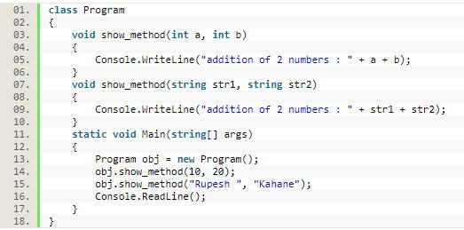

Slide 10
Operator Overloading
You can redefine or overload most of the built-in operators available in C#. Thus a programmer can use operators with user-defined types as well. Overloaded operators are functions with special names the keyword operator followed by the symbol for the operator being defined. similar to any other function, an overloaded operator has a return type and a parameter list.

Slide 11
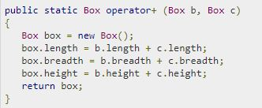

Slide 12
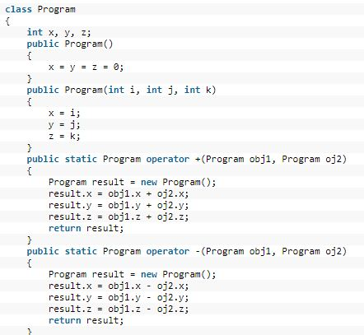

Slide 13
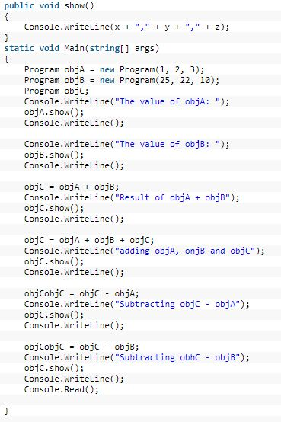

Slide 14
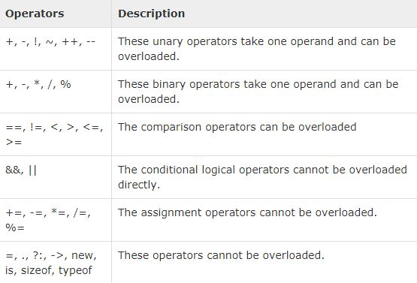

Slide 15
Runtime Polymorphism
Dynamic / runtime polymorphism is also known as late binding. Method overriding occurs when child class declares a method that has the same type arguments as a method declared by one of its superclass.
Method overriding forms Run-time polymorphism.

Slide 16
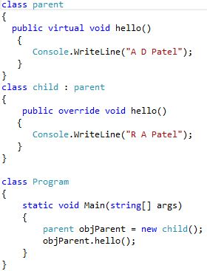

Slide 17
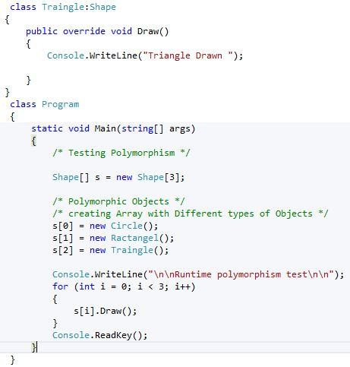
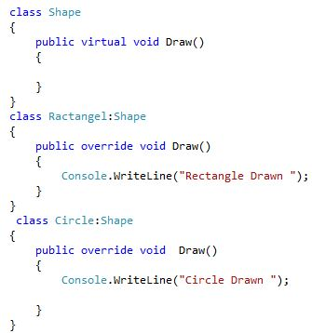

Slide 18
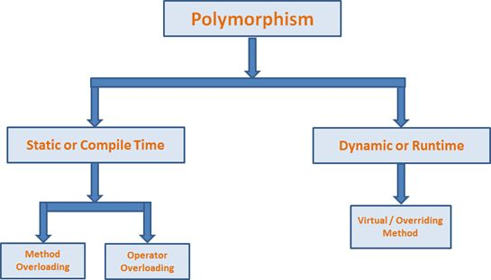

Slide 19
